Slide 1
Faculty Professional Development

Slide 2
New Faculty Orientation: A Year-Long Pilot
Hybrid format (online and in-person programming)
Year-long format with monthly sessions (informational and interactive)
WHY?
Allows new faculty time to process information and ask informed questions based on their experiences to date
Encourages new faculty to bond as a cohort, interact with their peers, and establish a network of colleagues outside of their department

Slide 3
Faculty Writing Groups
Benefits:
Cultivate community
Offer dedicated time for research (one-hour/week)
Opportunity for peer mentoring and exchange of ideas across fields/disciplines
Group Design:
4-6 participants
We *try* to accommodate faculty preferences (faculty of color, women, LGBTQIA, parents of small children)
When possible, groups do not have faculty from the same department/school to encourage open dialogue and interdisciplinary connections.
Writing groups are held in the fall, spring and summer terms.

Slide 4
Promotion and Tenure Support
Faculty Advocates (*part of NSF ADVANCE grant)
Consult with candidates about the process of developing their professional relationships, selecting external reviewers, and review promotion statement to offer feedback/advice
Preparing for Tenure and Promotion workshop
Review University processes and procedures
How to compose an impactful candidate statement
Use meaningful language for external and/or internal reviewers

Slide 5
Magis Faculty Fellowship
The Magis Faculty Fellowship provides professional development opportunities for senior faculty who are interested in exploring campus administration and leadership.
Faculty fellows participate in professional development activities to better understand the many roles of university leaders, to understand the unique meaning of leadership in a Jesuit context, and assess their interest in pursuing opportunities in academic administration.
*New applications will be accepted in March 2022

Slide 6
Special Events/Programs to Support Historically Underrepresented Faculty
Faculty of Color End-of-Semester Dinner (December 2021)
“Solo Success: How to THRIVE in the Academy When You are the Only_____” (January 2022)
How to Be an Ally to Underrepresented Faculty (February 2022)
Faculty of Color retreat at the Loyola University Retreat and Ecology Campus- “LUREC” (May 6-7, 2022)
Microgrant Program (*part of NSF ADVANCE grant) – Apply for funding to organize a mini-workshop with other women/WoC faculty in STEM fields from the Chicago area, as well as to support travel required to plan collaborative research with scholars outside of the Chicago area.

Slide 7
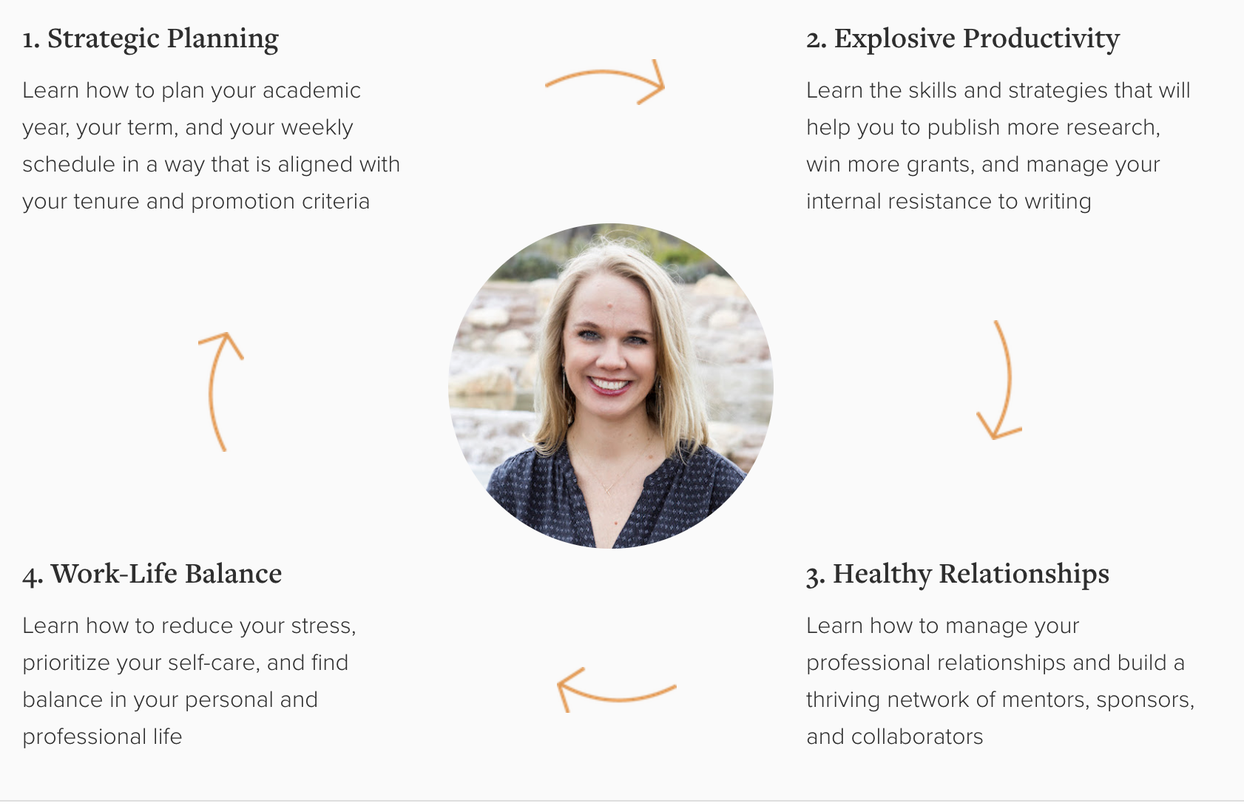
Campus-wide Engagement with NCFDD Core Curriculum
The NCFDD's Core Curriculum is designed to teach faculty the 10 key skills necessary to Thrive in the Academy.
Skill #1: Every Semester Needs a Plan
Skill #2: Align Your Time with Your Priorities
Skill #3: How to Develop a Daily Writing Practice
Skill #4: Mastering Academic Time Management
Skill #5: Moving from Resistance to Writing
Skill #6: The Art of Saying "No"
Skill #7: Cultivating Your Network of Mentors & Sponsors
Skill #8: Overcoming Academic Perfectionism
Skill #9: Engaging in Healthy Conflict
Skill #10: Strategies for Dealing with Stress & Rejection

Slide 8
Peer Mentoring Circles
Peer mentoring or "networked mentoring" creates a community of shared knowledges and experiences, meets the diverse needs of faculty mentees, and normalizes cultivating a support system of multiple mentors and sponsors.
Facilitated by senior faculty and comprised of 4-6 early career faculty.
We offer affinity-based peer mentoring groups in order to address the specific and unique challenges faced by underrepresented faculty
Senior faculty mentors must attend a mandatory workshop, which will cover how to cultivate trust, facilitate generative, solution-oriented dialogue, and how to address specific needs/challenges of URM faculty.

